Slide 1

Experiential Learning
Project Assessment-I on
“Simple Password Generator” under the course
Python Programming Language (N-PCCCM304P)
Presented By :
Siddhi Bamnote
[CM25053]
Under the Guidance
of
Mrs. Suchita Meshkar
Session:2026-27 (ODD )
Department of CSE(AI&ML)
S. B. JAIN INSTITUTE OF TECHNOLOGY MANAGEMENT AND RESEARCH,NAGPUR
An Autonomous Institute, Affiliated to RTMNU, Nagpur

Slide 2
Problem statement
People often use weak passwords like their names or 123456.
Weak passwords are very easy for hackers to guess.
It is hard for users to create strong, random passwords by themselves.
We need a simple Python program to make safe passwords automatically.

Slide 3
Objectives
To build a simple tool that creates strong and random passwords.
To let the user choose how long the password should be.
To let the user pick capital letters, small letters, numbers, and symbols.
To make sure at least one character from each choice is included.
To show if the generated password is Weak, Medium, or Strong.

Slide 4
Algorithm
Start the program.
Ask the user for the password length.
Ask the user to choose uppercase, lowercase, numbers, and symbols
Mix all chosen character types together.
Pick random characters until the full length is ready.
Shuffle the characters so the order is random.
Show the password and its strength rating.
Stop the program.

Slide 5
Flowchart/pseudocode
Start
1. User Enters Password Length
2. User Selects Letter/Number/Symbol Types
3. Mix Chosen Character Groups Together
4. Pick Characters Randomly
5. Shuffle Everything
6. Show Password and Strength
End

Slide 6
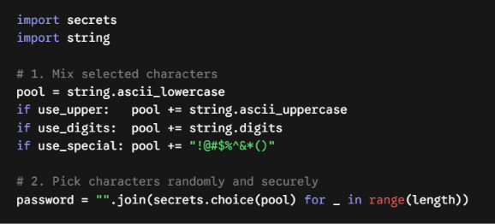
Understanding of Python logic

Slide 7
How it works & benefits
Simple Flow:
User Options → Combine Letters & Numbers → Pick Randomly → Safe Password
How it Works:
User Choice: User picks length and what characters to add.
Random Pick: Uses Python's secure secrets tool to pick random items.
Strength Check: Checks if password is long and has mixed characters.
Benefits:
  Makes passwords impossible to guess.
  Keeps online accounts safe from hackers.

Slide 8
GitHub Details & My Contribution
Repository Name : Python-simple-password-generator
My Contribution:
Understood the security needs and designed the simple algorithm.
Wrote the Python code using secrets and string.
Added safety checks and password strength test.
Created the GitHub repo and made this presentation.

Slide 9
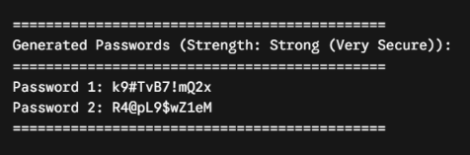
Result / Expected Output

Slide 10
Phase 2
S. B. Jain Institute of Technology Management and research

Slide 11
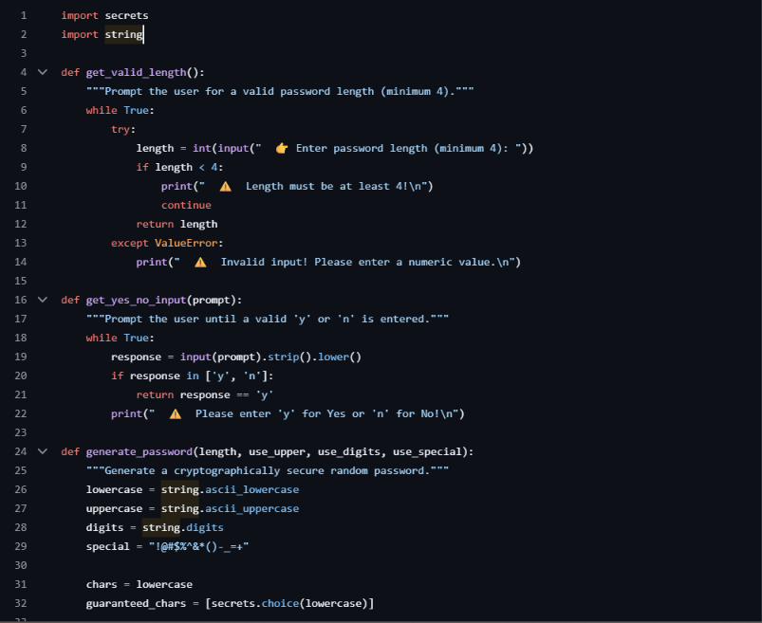
Phase 2 : Code

Slide 12
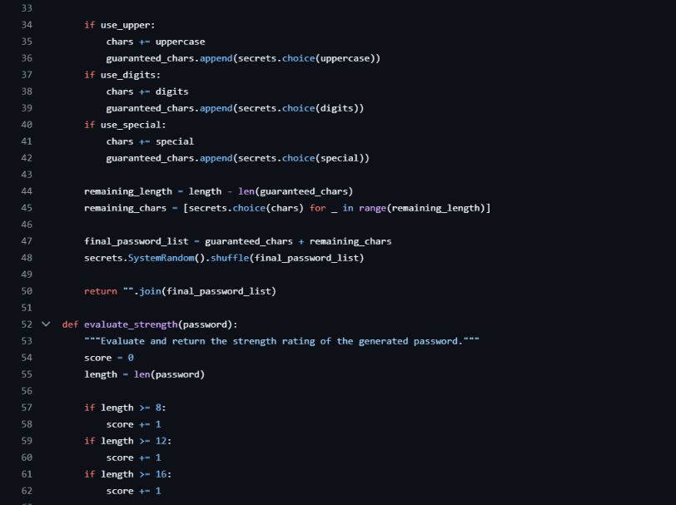

Slide 13
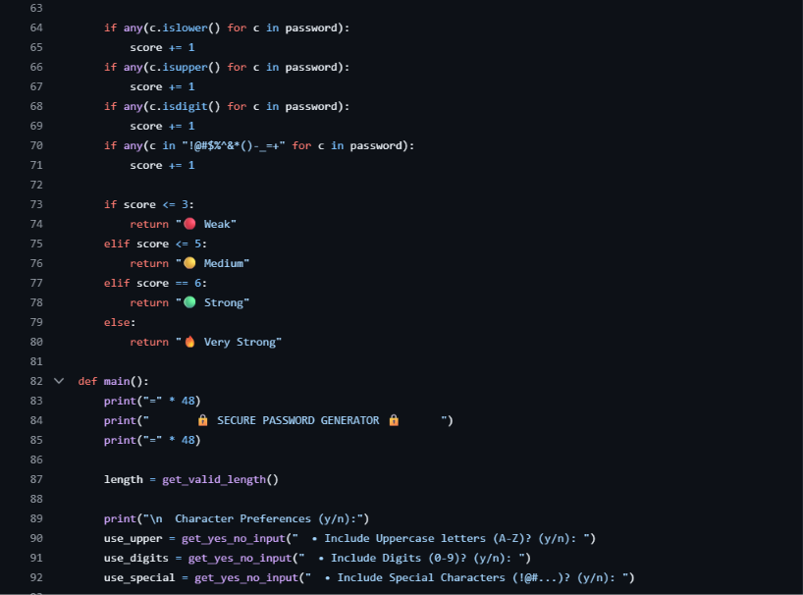

Slide 14
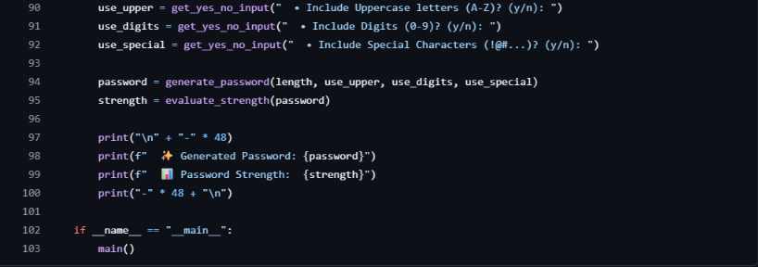

Slide 15
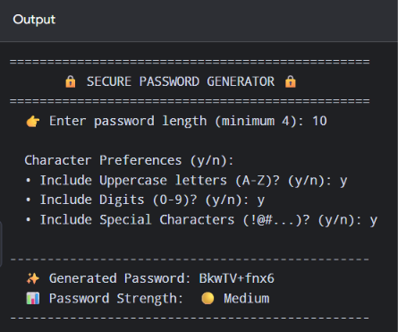

Slide 16
Phase 2 – Improvements Made
Added password length checking
Added options for Capital letters, Numbers and Special characters
Made sure at least one character from each selected option is included
Added random password generation
Added password shuffling
Added password strength checking
Shows password as Weak, Moderate or Strong
Improved the output screen
Tested the program with different inputs

Slide 17
Technologies Used
Python
Random module
String module
Functions
If-Else
Loops
User Input

Slide 18
Flowchart
Start
Enter Length
Select Types
Generate Password
Shuffle
Check Strength
Show Result
End

Slide 19
Conclusion
The Simple Password Generator is a simple and useful Python project.
It helps users create random and strong passwords easily.
The user can choose password length and character types.
This project helped us learn Python, random generation, conditions, and loops.

Slide 20
Phase 3
S. B. Jain Institute of Technology Management and research

Slide 21
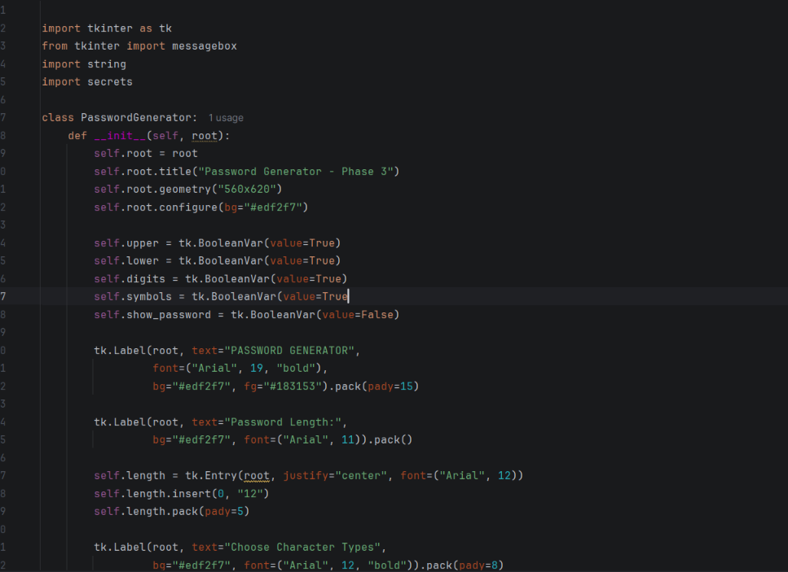
Code :

Slide 22
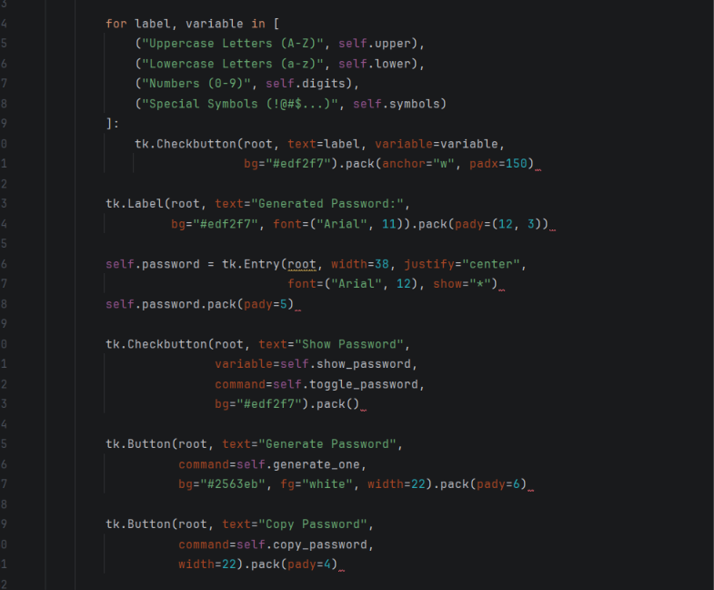

Slide 23
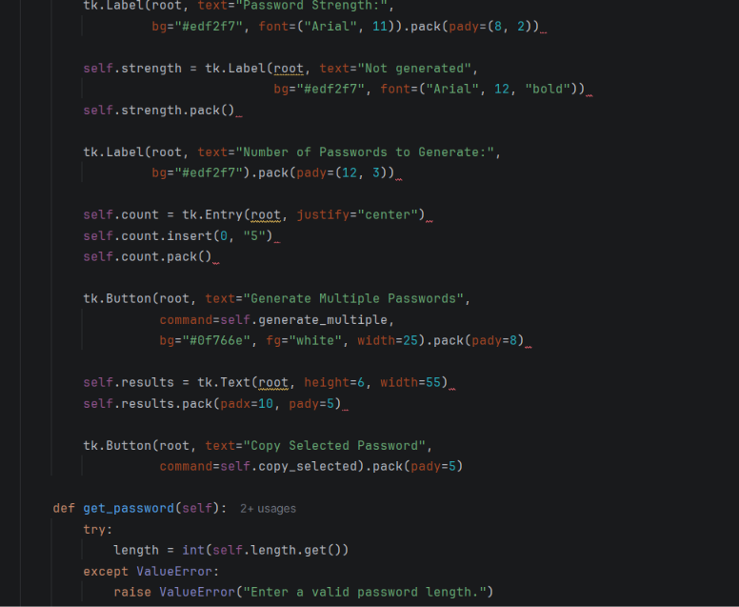

Slide 24
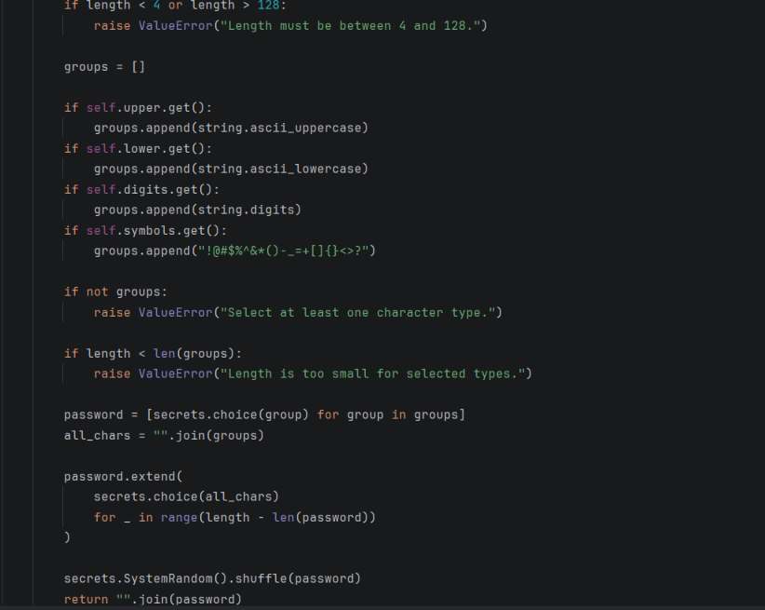

Slide 25
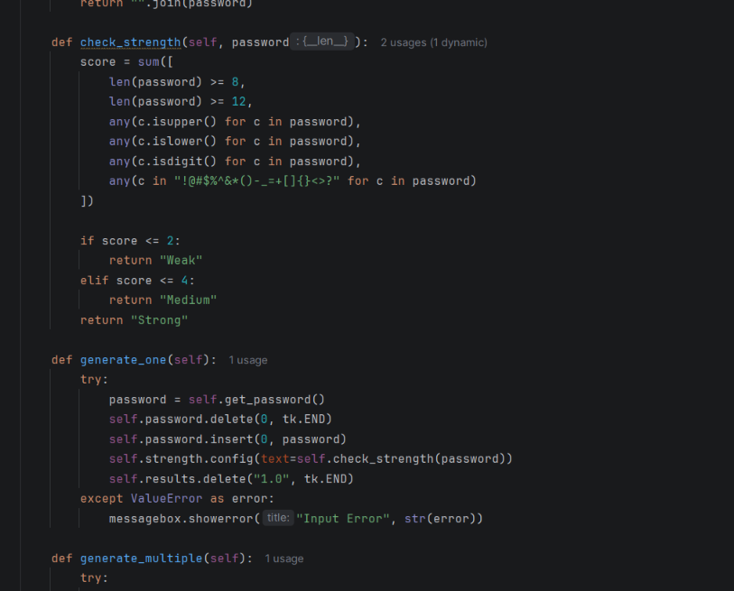

Slide 26
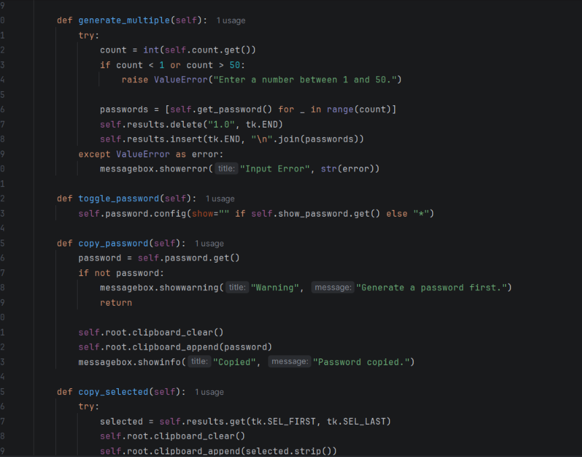

Slide 27
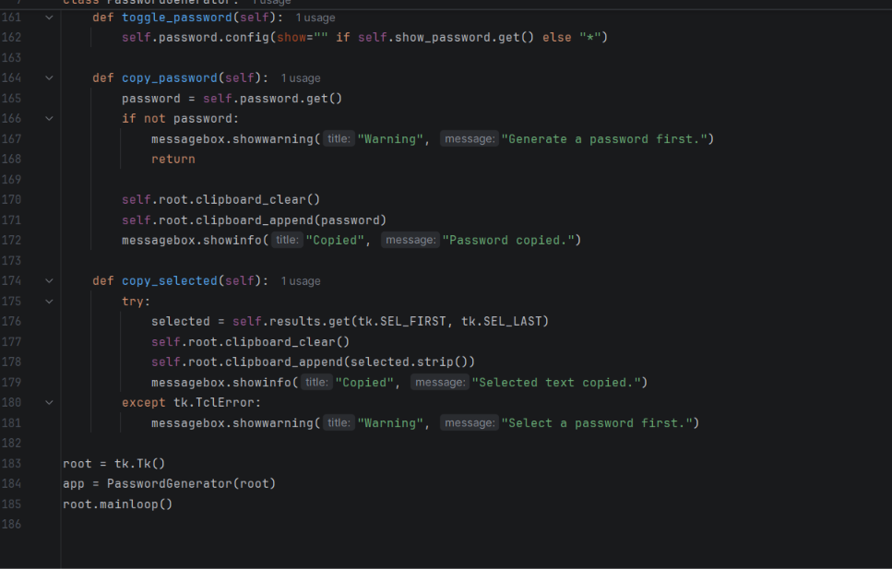

Slide 28
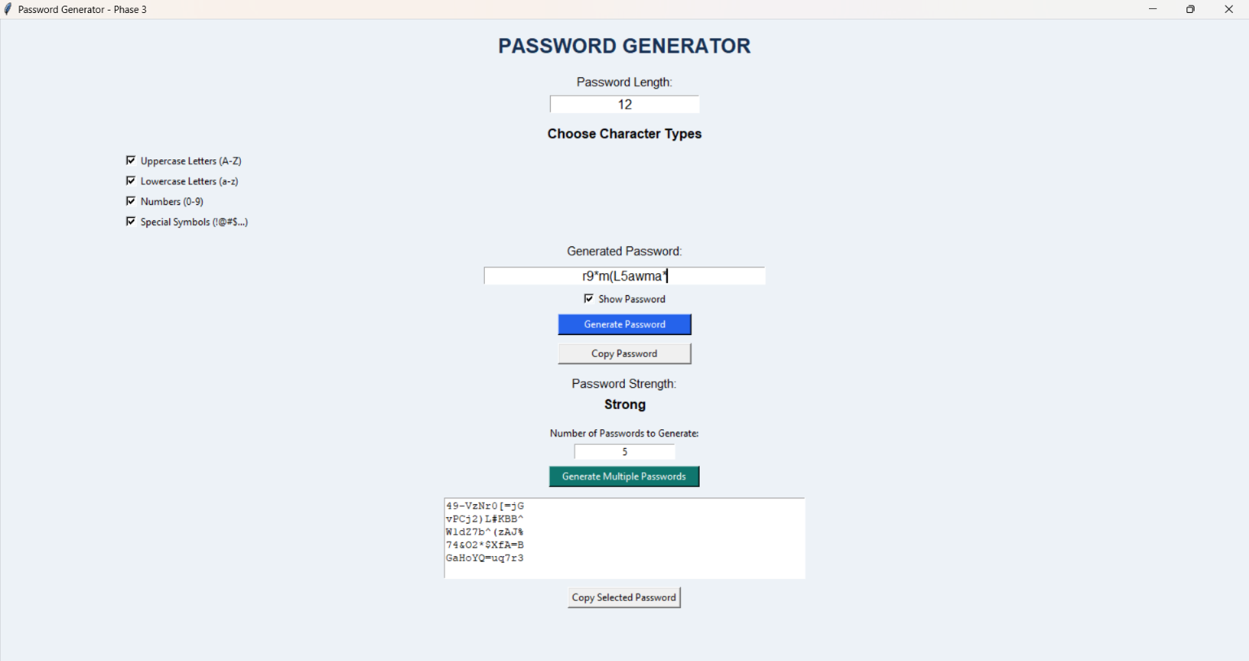
OUTPUT :

Slide 29
Phase 3 – Improvements Made
Improved password generation using Python.
Added a user-friendly graphical interface using Tkinter.
Added options to show or hide the generated password.
Added a copy-password button.
Added an option to generate multiple passwords.
Improved input validation for password length.
Improved password strength checking.
Added error messages for invalid inputs.
Improved the overall design and output display.
Tested the program with different inputs.

Slide 30
Technologies Used
Python
Tkinter
Secrets module
String module
Functions and conditional statements
Loops and input validation

Slide 31
Thank You
S. B. Jain Institute of Technology Management and research

